Slide 1




Linked Lists
Linked Lists
Notes:
Sequences

Slide 2
Array vs Linked List
Disadvantages of arrays as storage data structures
  The length of a dynamic array might be longer than the actual number of elements that it stores.
  Amortized bounds for operations may be unacceptable in real-time systems.
  Insertions and deletions at interior positions of an array are expensive
  Fixed size
Notes:
Slow searching in unordered array
Slow insertion in ordered array
Sequences

Slide 3
Array vs Linked List
Linked lists
  More complex to code and manage
  Dynamic
    A linked list can easily grow and shrink in size
    Data items are allocated in memory as needed
  Easy and fast insertions and deletions
    Only need to modify references: data items stay where they are
Notes:
Sequences

Slide 4
References vs. objects
variable = value
  a variable (left side of = ) is an arrow (the base of an arrow)
  a value (right side of = ) is an object (a box; what an arrow points at)
For the list at right:
  a.next = value
  means to adjust where points
  variable = a.next
  means to make variable point at
2
1
data | next
10
data | next
20
a
1
2
Notes:
Sequences

Slide 5
Reassigning references
when you say:
  a.next = b.next;
you are saying:
  "Make the variable a.next refer to the same value as b.next."
  Or, "Make a.next point to the same place that b.next points."
data | next
10
data | next
20
a
data | next
30
data | next
40
b

Slide 6
The Many-Faced Data Structure
Linked Lists come in many forms
  Single-Linked
  Double-Ended
  Circular
  Double-Linked
  Positional List

Slide 7
The Node Class for List Nodes
class Node:
def __init__ (self, element, next=None):
# initialize node’s fields
self.data = element # reference to user’s element
self.next = next # reference to next node
Linked Lists

Slide 8
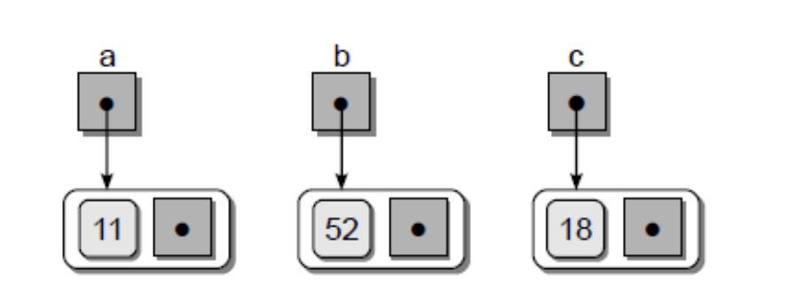
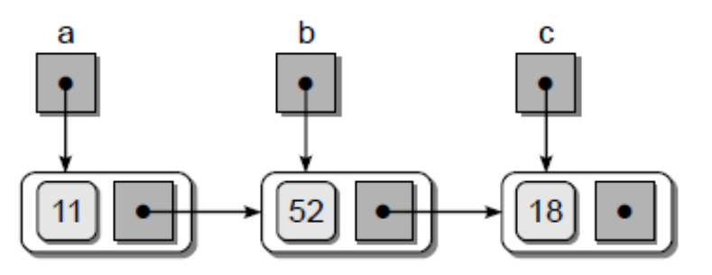
Creating a LinkedList
a = Node( 11 )
b = Node( 52 )
c = Node( 18 )
a.next = b
b.next = c
Linked Lists

Slide 9
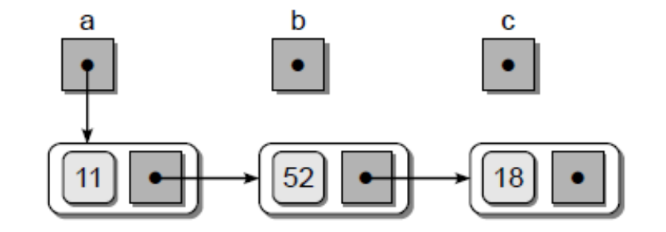
Creating a LinkedList
b = None
c = None
print( a.data ) # Output: 11
print( a.next.data ) # Output: 52
print( a.next.next.data ) # Output: 18
Linked Lists

Slide 10
More terminology
A node's successor is the next node in the sequence
  The last node has no successor
A node's predecessor is the previous node in the sequence
  The first node has no predecessor
A list's length is the number of elements in it
  A list may be empty (contain no elements)

Slide 11
Singly Linked List
A singly linked list is a concrete data structure consisting of a sequence of nodes, starting from a head pointer
Each node stores
  element
  link to the next node
next
elem
node
head
∅
A
B
C
D
Linked Lists
Notes:
Sequences

Slide 12
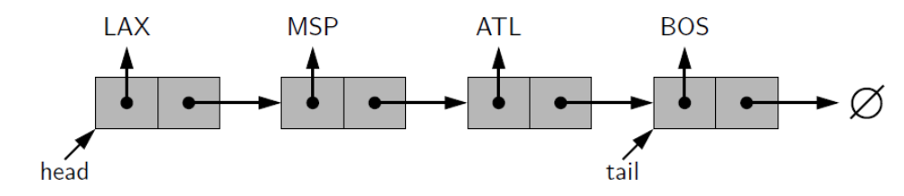
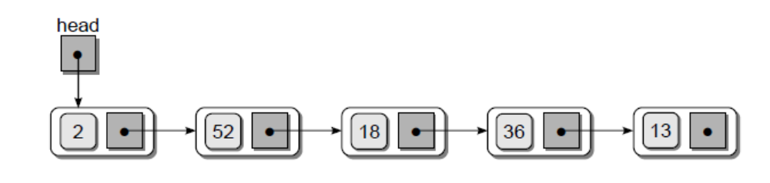
Other Single LinkedLists
∅
Linked Lists

Slide 13
Operations on an SLL
Insertion
Deletion
Search or Iteration through the list to display items

Slide 14
Inserting/Removing an SLL Node
Many ways to insert/remove a list node
  As the new first element
  As the new last element
  Before a given node (specified by a reference)
  After a given node
  Before a given value
  After a given value
All are possible, but differ in difficulty

Slide 15
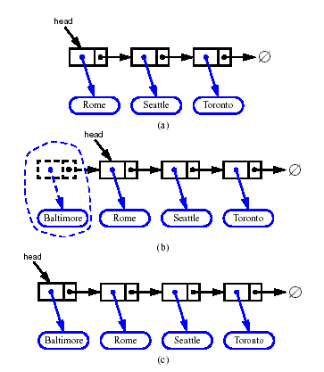
Inserting at the Head
Allocate a new node
Insert new element
Have new node point to old head
Update head to point to new node
Linked Lists
Notes:
Algorithm add first(L,e):
newest = Node(e) {create new node instance storing reference to element e}
newest.next = L.head {set new node’s next to reference the old head node}
L.head = newest {set variable head to reference the new node}
L.size = L.size+1 {increment the node count}
Sequences

Slide 16
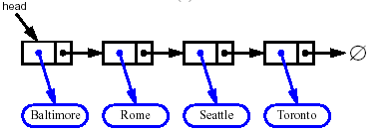


Removing at the Head
Update head to point to next node in the list
Allow garbage collector to reclaim the former first node
Linked Lists
Notes:
Algorithm remove first(L):
If L.head is None then
Indicate an error: the list is empty.
L.head = L.head.next {make head point to next node (or None)}
L.size = L.size−1 {decrement the node count}
Sequences

Slide 17
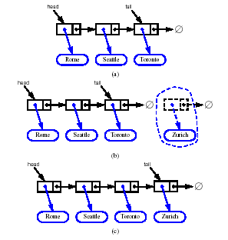
Inserting at the Tail
Allocate a new node
Insert new element
Have new node point to null
Have old last node point to new node
Update tail to point to new node
Linked Lists
Notes:
Algorithm add last(L,e):
newest = Node(e) {create new node instance storing reference to element e}
newest.next = None {set new node’s next to reference the None object}
L.tail.next = newest {make old tail node point to new node}
L.tail = newest {set variable tail to reference the new node}
L.size = L.size+1 {increment the node count}
Sequences

Slide 18
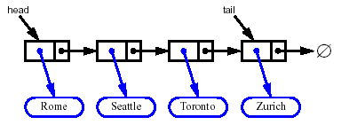
Removing at the Tail
Removing at the tail of a singly linked list is not efficient!
There is no constant-time way to update the tail to point to the previous node
Linked Lists

Slide 19
Traversing the Nodes
def traversal( head ):
while head is not None :
print(head.data)
head = head.next
∅
Linked Lists
Notes:
Sequences

Slide 20
Traversing the Nodes
def traversal( head ):
curNode = head
while curNode is not None :
print(curNode.data)
curNode = curNode.next
∅
Linked Lists

Slide 21
Traversing an SLL
curNode
head
one
two
four

Slide 22
Searching for a Node
def unorderedSearch( head, target ):
curNode = head
while curNode is not None and curNode.data != target:
curNode = curNode.next
return curNode is not None
∅
Linked Lists

Slide 23
Linked List Efficiency
Insertion and deletion at the beginning of the list are very fast
O(1)
Search, deletion, insertion require traversal
O(n)
Same number of comparisons as arrays
But no shifting of items required after insertion or deletion
Memory print strictly limited to usage and can shrink/expand

Slide 24
Let’s Implement Single Linked List
Open Single_linked_list_Students.py file.
Complete the insertAtFirst(e), deleteFirst(),unOrderedSearch(e) functions.
Linked Lists

Slide 25
Stack as a Linked List
We can implement a stack with a singly linked list
The top element is stored at the first node of the list
The space used is O(n) and each operation of the Stack ADT takes O(1) time
nodes
t
∅
elements
Linked Lists

Slide 26
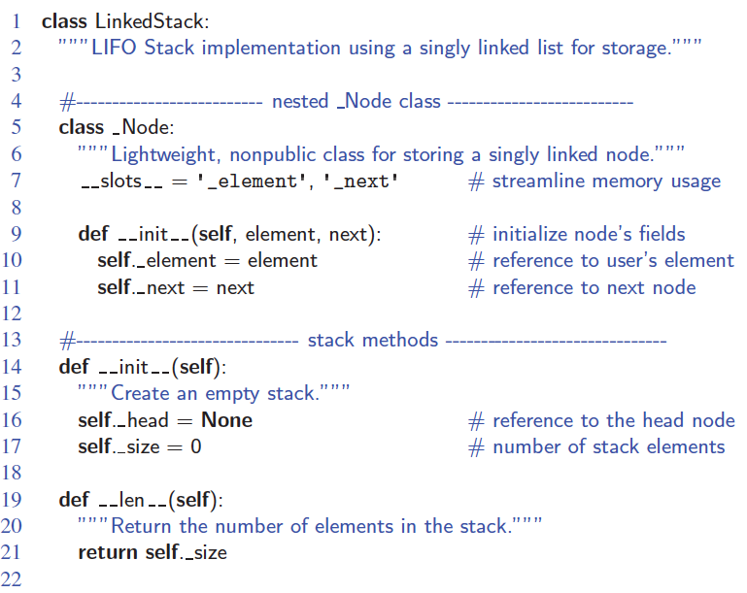
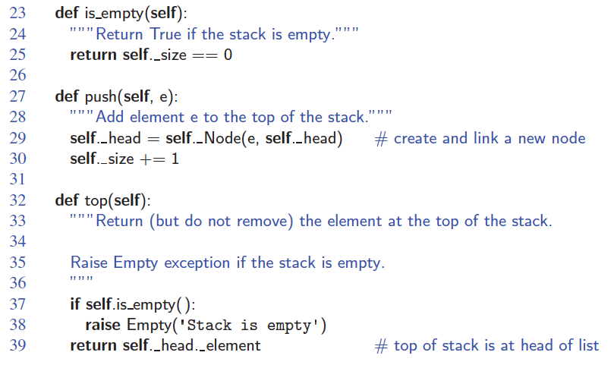
Linked-List Stack in Python
Linked Lists

Slide 27
Queue as a Linked List
We can implement a queue with a singly linked list
  The front element is stored at the first node
  The rear element is stored at the last node
The space used is O(n) and each operation of the Queue ADT takes O(1) time
r
nodes
f
∅
elements
Linked Lists

Slide 28
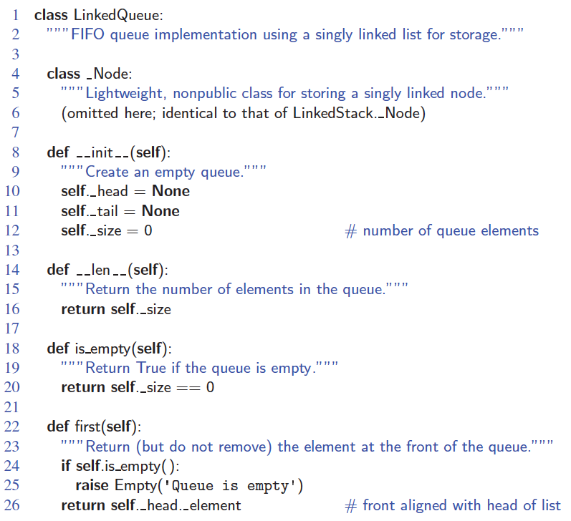
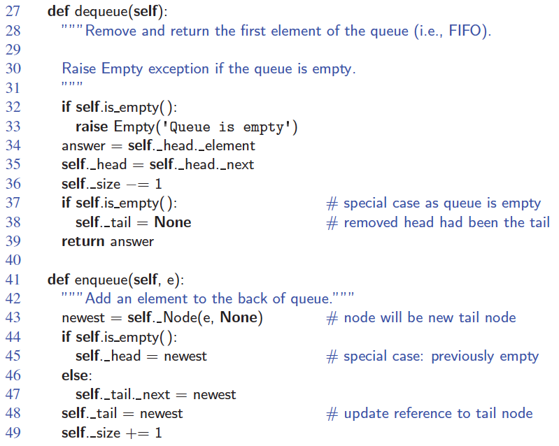
Linked-List Queue in Python
Linked Lists

Slide 29
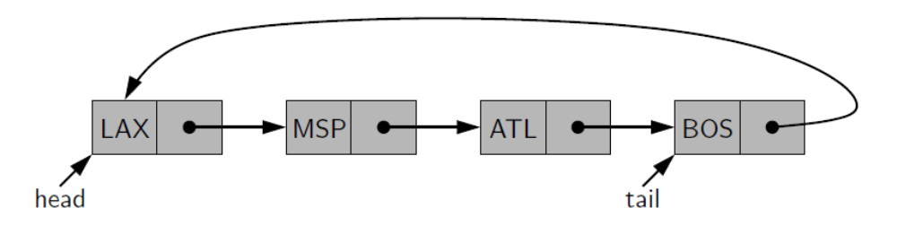
Circularly Linked Lists
When is a list traversal complete?
Linked Lists
Notes:
(hint: use your Head)
Sequences

Slide 30
Inserting After
(More Operation of SLL)
node
three
numerals
one
two
four
Find the node you want to insert after
First, copy the link from the node that's already in the list
Then, change the link in the node that's already in the list

Slide 31
Deleting an Element From an SLL (More Operations of SLL)
• To delete the first element, change the link in the header
numerals
one
two
three
• To delete some other element, change the link in its predecessor
numerals
one
two
three
• Deleted nodes will eventually be garbage collected

Slide 32
LinkedLists in Action
Visualization time
  https://visualgo.net/en/list

